Slide 1
U.S. Political Parties

Slide 2
American Political Parties
The Basics:
Divided government exists at the national level (Democrats control the presidency and the U.S. Senate; Republicans control the U.S. House)
The President: Joe Biden (Democrat)
Partisan split in the US Congress (2023)
US House: 222 Republicans; 213 Democrats
The composition of the US House changes fairly often between elections, usually because of resignations, deaths (due to old age), crime, and scandals.
2017 – Resignations or retirements due to allegations of sexual harassment: John Conyers (D-MI), Blake Farenthold (R-TX), Trent Franks (R-AZ), Alcee Hasting (D-FL), Ruben Jesus Kihuen Bernal (D-NV)
Dec. 2020 – Luke Letlow (R-LA) died of COVID-19, having just won a seat in Nov. 2020
US Senate: 51 Democrats; 49 Republicans
2 Democratic Senators call themselves Independent Democrats
The US Supreme Court: a 6 to 3 conservative to liberal split
Trump had confirmed Neil Gorsuch, Brett Kavanaugh, and Amy Coney Barrett, each is expected to be conservative in the long run, but there is no guarantee that will be the case
Chief Justice John Roberts is a conservative but he has increasingly sided with the liberal bloc on the Court, e.g., on abortion rights, on defending ObamaCare, to protect his vision as to how the Court should respect the decisions of the elected branches of government
Notes:
Some examples as to why the numbers in the U.S. House often fall below 435 because of resignations, deaths, crime and scandal:
Jan. 2014 – Michael Grimm (R-NY) resigned, indicted on tax fraud
Feb. 2015 – Alan Nunnelee (R-MS) died of brain cancer
Mar. 2015 – Aaron Schock (R-IL) resigned, exposed for using taxpayer money for personal vacations (he posted pictures from these trips on social media)
Source (sexual harassment in 2017): https://en.wikipedia.org/wiki/2017_United_States_political_sexual_scandals#Allegations_against_members_of_the_United_States_House_of_Representatives
2020 United States House of Representatives elections – Wikipedia – Three (3) Democratic members of the U.S. House will join the Biden administration, so the Democratic majority in the House will shrink from 222 to 219, temporarily. Special elections will be held for these seats at some point in 2021, and Democrats should win each easily, bringing the Democratic majority back up to 222. Still, Republicans picked up 13 seats in the U.S. House in the 2020 elections. Democrats netted 3 seats in the U.S. Senate in 2020-21, including both Senate seats in a special election in Georgia. Trump suppressed the Republican vote in the Georgia Senate runoffs on Jan. 5, 2021 by alleging voter fraud in that state, a state he lost by 0.3% (about 12,000 votes).
US Supreme Court Chief Justice John Roberts is a conservative but he has increasingly sided with the liberal bloc on the Court, e.g., on abortion rights, on defending ObamaCare, to protect his vision as to how the Court should respect the decisions of the elected branches of government.
Here is the status of Texas:
The Governor of Texas: Greg Abbott (Republican). All other executive positions in Texas are held by Republicans
Partisan split in the Texas Legislature (2021)
The Texas House : 83 Republicans 67 Democrats
The Texas Senate: 18 Republicans 13 Democrats
Partisan split in the Texas Legislature (2019)
The Texas House : 83 Republicans 67 Democrats
The Texas Senate: 19 Republicans 12 Democrats
Partisan split in the Texas Legislature (2017)
The Texas House : 95 Republicans 55 Democrats
The Texas Senate: 20 Republicans 11 Democrats
Partisan split in the Texas Legislature (2015)
Texas House: 98 Republicans 52 Democrats
Texas Senate: 20 Republicans 11 Democrats
Partisan split in the Texas Legislature (2013)
Texas House: 95 Republicans 55 Democrats
Texas Senate: 19 Republicans 12 Democrats
Partisan split in the Texas Legislature (2011)
Texas House: 101 Republicans 49 Democrats
Texas Senate: 19 Republicans 12 Democrats
2020 Election Cycle
2018 Election Cycle
The 2018 congressional elections were a “wave” election for the Democrats in the U.S. House, with Democrats picking up 40 seats and recapturing the majority. In the US Senate, Republicans stymied the Democrats how. However, the Republicans held on to their majorities in both chambers, which was a victory for Republicans because many pre-election predictions showed that Democrats would win a majority in the US Senate, but that did not happen.
Here are the results:
US House: 235 Democrats; 199 Republicans
US Senate: 53 Republicans; 47 Democrats
2016 Election Cycle
The 2016 congressional elections slightly favored the Democrats, with Democrats picking up 2 seats in the US Senate and 5 seats in the US House. However, the Republicans held on to their majorities in both chambers, which was a victory for Republicans because many pre-election predictions showed that Democrats would win a majority in the US Senate, but that did not happen.
2014 Election Cycle
Republicans netted 13 more seats in the House and 9 seats in the Senate in the 2014 midterm elections. The last time Republicans in the House had a majority this strong was 1928. Republicans campaigned against President Obama’s agenda and it worked. They did not present a Republican agenda, which worried some Republican supporters going into the election, but the anti-Obama sentiment was strong enough to benefit Republicans.
The real fight in 2014 was over which party would control the Senate. Most polls predicted Republicans would pick up 6 seats, which is what they needed to take a majority from the Democrats, but in the end, Senate Republicans did better than predicted, picking up 9 seats, the most of any party since the 1980 elections. 5 Democratic incumbents lost, most from “red” states (Oklahoma, Louisiana, Alaska, North Carolina, Colorado). Democrats often ran against Obama, hoping not to lose votes to the anti-Obama sentiment in the country. For instance, Alison Lundergan Grimes ran ads showing her shooting a hunting rifle and saying “I’m not Barack Obama.” Democrats hoped Grimes could unseat Mitch McConnell (the then Senate Minority Leader), but McConnell won the race on election night by a much wider margin than expected.
Source: http://en.wikipedia.org/wiki/United_States_House_elections,_2012; http://en.wikipedia.org/wiki/United_States_Senate_elections,_2012; http://www.sourcewatch.org/index.php?title=111th_Congress
2012 Election Cycle
Not only did Barack Obama win reelection, but Democrats picked up 8 seats in the U.S. House and 2 seats in the U.S. Senate. What was probably most notable about congressional elections in 2012 is the mistakes Republican Senate candidates made during the campaign. Todd Akin was the Republican nominee for a Senate seat in Missouri, and when asked about the abortion issue, he said that when a “legitimate rape” occurs, a woman’s body has a way to shut that down (meaning that biologically, the woman body will block the pregnancy such that it doesn’t occur). In Indiana, Richard Mourdock, another Republican Senate candidate, said that if a pregnancy occurs as a result of rape then that is “God’s will.” Both comments were foolish, and both candidates lost their respective bids for the U.S. Senate, in states where the Republican candidate should have won. Democrats claimed that Republicans were waging a “war on women,” and these comments fueled that accusation.
Republicans had hoped to win a majority in the U.S. Senate in 2012, but in the end, they lost 2 seats, resulting in a stronger Democratic majority. Republicans held on to the majority in the U.S. House, so there is divided government at the national level.
The Independents: Angus King won a Senate seat in Maine as an Independent, but he caucuses (votes) with the Democrats. King replaced Olympia Snowe (R-ME), who retired because she was tired of the hyper-partisanship in American politics. Bernie Sanders is an Independent from Vermont; he calls himself a Democratic socialist, and he too caucuses with the Democrats. Joe Lieberman (D-CT) retired in 2012—he was an independent as well, who voted with the Democrats on most issues but sided with Republicans on matters involving national security.
2011
A couple of sex scandals affected the composition of members in the US House in 2011. Rep. Lee (R-NY) resigned after being caught trying to date a woman he met on Craig’s List. Lee lied about his age, marital status, and occupation, and a woman who was considering a date with Lee did some research to uncover the lies. She then reported Rep. Lee to a tabloid magazine, which broke the story. Lee immediately resigned his seat in the US House once the story broke, and the seat was filled in a special election by Kathy Hochul (D-NY) in May 2011. In a second sex scandal, Rep. Weiner (D-NY) resigned after having sexually explicit text-message exchanges with several women. A conservative blogger was informed of Weiner’s behavior and exposed to the country a picture Weiner had posted of himself in his underwear. For two weeks, Weiner denied that he had posted the picture for two weeks after the story broke, but when the Democratic leaders in Congress failed to come to his defense, Weiner admitted to posting the picture and resigned his seat in the US House. Weiner’s seat was filled in a special election by Bob Turner (R-NY) in Sept. 2011.
Kathy Hochul’s victory in New York district #26 in May 2011 may signal a Democratic comeback in 2012. She ran on keeping Medicare intact as it currently exists, in contrast to Paul Ryan’s (R-WI) plan to restructure Medicare into a voucher program. Hochul replaced Christopher Lee (R-NY) (mentioned above). Following Hochul’s victory, Democrats across the country are planning to run against Paul Ryan’s Medicare reform proposal. We’ll see if that works. There is counter-evidence though. Bob Turner’s (R-NY) victory in New York District #9 in Sept. 2011 may signal another Republican victory in 2012. Turner replaced Anthony Weiner (D-NY) (also mentioned above). Turner won in a district that had been held by Democrats since 1923, and he ran against Obama’s policies toward Israel and gay marriage. The district had a large Jewish population, and former NY Mayor Koch (a Jew) campaigned hard against Obama. The president had made a speech earlier in 2011 in which he said the borders between an Israeli state and a Palestinian state should be defined by the armistice agreement in 1949 following the 1948 war (which Israel won). Natanyahu, the PM of Israel, rejects the 1948 borders, believing them to tempt Israel’s enemies to attack because Israel is only 9 miles wide with those borders, thus appearing to be more vulnerable. In America, a high-ranking politician cannot go against Isreali interests; the Israeli lobby in America is just too powerful. Obama appeared to go against Israel’s interests when he endorsed the 1948 borders, and he paid the price for that in NY-9.
Here are some composition changes that occurred in 2015. Aaron Schock (R-IL) resigned after he was exposed for using taxpayer money for personal vacations all over the world (he posted pictures from these trips on social media). Michael Grimm (R-NY) resigned after being indicted on tax fraud, underreporting income. Alan Nunnelee (R-MS) died of brain cancer in Feb. 2015
Source: http://www.sourcewatch.org/index.php?title=2008_congressional_elections ; http://en.wikipedia.org/wiki/112th_United_States_Congress; http://en.wikipedia.org/wiki/United_States_Senate_elections,_2010; http://en.wikipedia.org/wiki/US_House_election,_2010; http://en.wikipedia.org/wiki/United_States_congressional_delegations_from_Texas; http://www.sourcewatch.org/index.php?title=111th_Congress
2010
The 2010 election cycle was a Republican “wave.” 682 seats at the local, state and national level switched from Democratic control to Republican. That exceeds the 625 seats that switched from Republican to Democratic control in the 1974 elections cycle, following the Watergate scandal (which tainted Republicans as corrupt). There was no major scandal in 2010, but what galvanized Republicans was President Obama’s and the Democratic Congress’ health care law (passed in Mar. 2010). The Tea Party rose in opposition to health care, and more generally, to the move toward “bigger government” by Obama and Democrats in Congress. The Republicans won 63 seats in the US House, winning a majority in that chamber. These numbers are historic. A 63-seat swing is the largest since 1948 (which was a presidential election, not a midterm). In the US Senate, the Republicans picked up 6 seats, but Democrats still held on to a majority in that chamber. So, coming out of the 2010 midterm elections, there was divided government in Congress. Republicans made historic gains in state elections in Texas and around the country also. 11 state legislatures switched from Democratic majorities to Republican majorities, and 12 governors switched from Democrats to Republicans. In Texas, Rick Perry was elected governor for a 3rd time, and Republicans won all other executive positions in Texas government. In the Texas House elections, Republicans picked up 25 seats, and Republicans maintained control of the Texas Senate. State elections were important because in 2011 the state legislatures around the country would redraw district boundaries for their respective legislative seats at the state level and for seats in the US House, and many of these states are now controlled by Republicans and will draw district boundaries to help the chances of Republicans in elections that will occur between over the next decade, until a new census is taken in 2020 and the district lines are redrawn again.
The coming Republican wave was evident early in 2010. In January 2010, Massachusetts held a special election to fill the US Senate seat Ted Kennedy had held for 46 years (Kennedy died of brain cancer in 2009). Surprisingly, a Republican (Scott Brown) won the special election. Brown made opposition to Obama’s heath care plan the focus of his campaign, and the Massachusetts voters responded favorably to Brown’s message, despite that Ted Kennedy had been a champion of health care reform for decades (and the same Massachusetts electorate elected Kennedy seven times). Some political analysts predicted that the special election in Massachusetts portended a nationwide trend, a backlash against the Democratic leadership in Congress and against President Obama. They also point to the Governor’s races in NJ and Virginia (Nov. 2009), both of which were won by Republicans. These political analysts turned out to be right. 2010 was a big year for Republicans.
Kathy Hochul’s victory in New York district #26 in May 2011 may signal a Democratic comeback in 2012. She ran on keeping Medicare intact as it currently exists, in contrast to Paul Ryan’s (R-WI) plan to restructure Medicare into a voucher program. Now Democrats across the country are planning to run against Paul Ryan’s Medicare reform proposal. We’ll see if that works.
The Independent Democrats: Senator Lieberman (CT) lost in the Democratic primary in Aug 2006 but then ran as an independent in the general election and defeated the Democratic and Republican candidates in Nov 2006. Senator Sanders (VT) retired from the House and ran and won a Senate seat as a socialist candidate. Both Lieberman and Sanders vote with Democrats, though Lieberman supported Bush on the issue of the Iraq War (that’s why he was defeated in the Democratic primaries in Aug 2006). Lieberman is too conservative for Connecticut and has decided not to run for reelection in 2012.
2008
In the 2008 elections, Democrats increased their margins over Republicans. The Democrats picked up an additional 21 seats in the US House and 8 seats in the US Senate. It was another Democratic “wave” election. In the Senate, just after the election, the Democrats had a near filibuster-proof Senate, meaning that the Republicans had little chance of blocking any legislation the Democrats desire. (A filibuster occurs when at least 41 Senators combine forces to block legislation. The filibuster can be broken by a vote of 60 Senators, then the full Senate can vote on the measure.) In April 2009, Senator Arlen Specter (Pennsylvania) switched parties from the Republican Party to the Democratic Party. Specter said the Republican Party had moved too far right and that he finds himself more aligned with the Democratic philosophy; he also believed he could not win in the Republican primaries in the next election cycle. Specter switch gave the Democrats 59 seats in the US Senate, and once the Minnesota Supreme Court found Al Franken to be the winner of the seat in Minnesota (it took 8 months to decide the Senate race in Minnesota), the Democrats had 60 seats in the US Senate (in 2009). Interestingly, Arlen Specter lost his bid to win the Democratic primary in Mar. 2010, in part because the voting public in PA. objected to Specter’s switch to the Democratic Party. Specter switched parties simply for political reasons—he believed he could not win the Republican nomination in 2010, so he became a Democrat, believing that he had a better chance of winning the Democratic nomination, but he turned out to be wrong.
The balance of power between 2008 and 2010: US House: 255 Democrats; 177 Republicans (1 Democrat and 2 Republicans had resigned between elections…The US House was 3 members short in 2010 due to these resignations); US Senate: 59 Democrats; 41 Republicans (2 Democratic Senators call themselves Independent Democrats)
2006
The 2006 midterm election was a “Democratic” wave, meaning the Democrats did exceptionally well. Democrats won majorities in both the US House and US Senate in the 2006 midterm elections (Nov 2006), so power in both chambers switched from Republican to Democratic. Republicans had previously controlled both chambers from 1994 to 2006. In Texas, Democrats did better than usual but not well enough to win majorities in the Texas Legislature. Democrats picked up 5 seats in the Texas House, but Republicans picked up 1 seat in the Texas Senate. The balance of power after the 2006 elections -- US House: 233 Democrats; 202 Republicans. Between 2006 and 2008, Democrats picked up 3 seats in special elections (the incumbent resigned). These three were strong Republican seats, but Democrats won them.
Additional Information
The Clerk of the House maintains the balance of power numbers.
Divided government occurs when the president (or governor) is of one party, and at least one chamber of Congress (or at least one chamber of the Texas Legislature) is controlled by a majority of the other party.
The members (18 in total) on the high courts in Texas are all Republicans, except one who switched from Republican to Democrat after being elected as a Republican.

Slide 3
Lecture Outline
Why a 2-party system?
3rd Parties in America
Party Issue Advantages
The players in the Republican and Democratic Parties
The Politician’s Dilemma
Appeal to core base (the ideologues) or to moderates?
Trends toward polarization in American Politics
History of American Political Parties

Slide 4
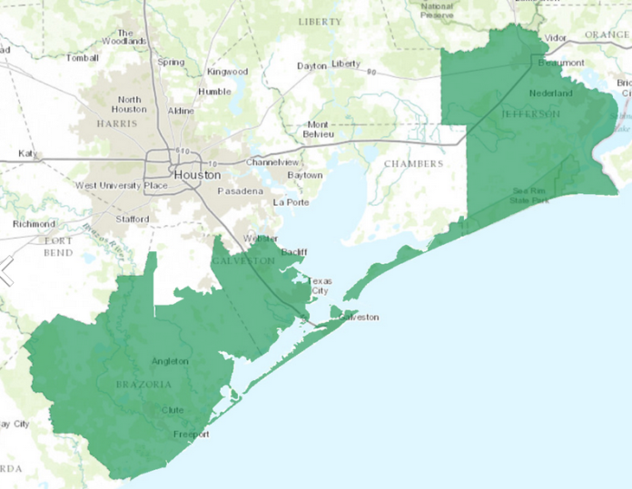
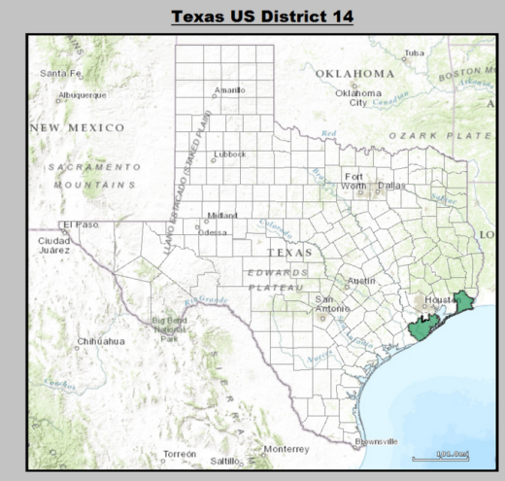
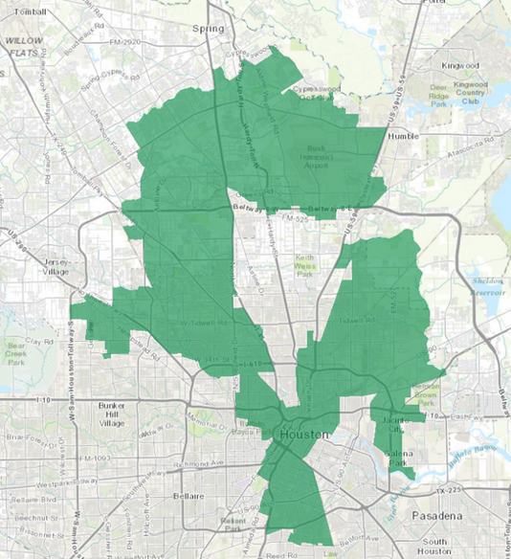
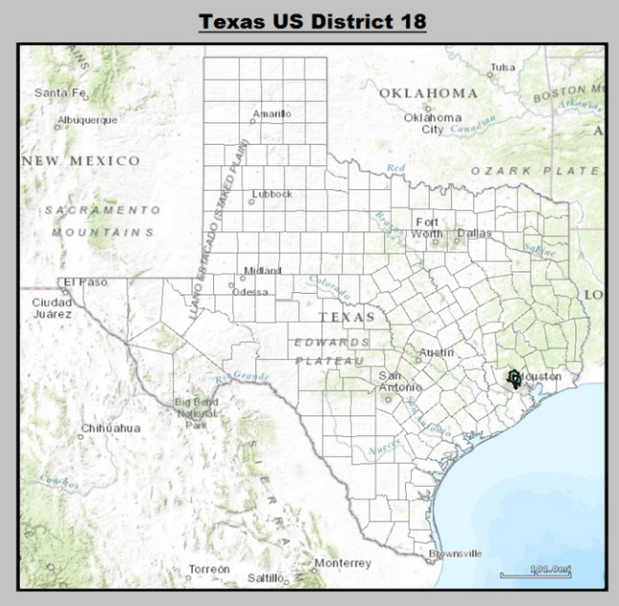
US House Districts in Texas Examples of Geographically-Enclosed Districts
Congressional districts are designed to have about 1,000,000 people
One candidate from each district is elected – an electoral system with “single member” districts tends to produce a two-party system
District 14 – Ron Paul (R-TX) held the seat for Texas District 14 (1994-2012)
District 18 – Sheila Jackson Lee (D-TX) holds the seat for Texas Congressional District 18
Notes:
Source: https://en.wikipedia.org/wiki/United_States_congressional_delegations_from_Texas#/media/File:Texas_US_Congressional_District_14_%28since_2013%29.tif
Source: https://en.wikipedia.org/wiki/United_States_congressional_delegations_from_Texas#/media/File:Texas_US_Congressional_District_18_%28since_2013%29.tif
Paul Weber (R) is the representative of District 14 today.

Slide 5
A Plurality Electoral System – The candidate or party which wins the most votes (not necessarily a majority but a plurality) captures the seat in government. In all scenarios—two parties, three parties, four parties or five parties competing for office, 50% of the vote (plus one) would win…Plurality electoral systems tend toward two parties because in a two-party system, 50% (plus one) guaranteed for one of the parties
In the first scenario below, party #4 would win the seat in government, but…
Party #1
Party #2
Party #3
Party #4
Party #5
Wins 20%
Wins 20%
Wins 20%
Wins 21%
Wins 19%
In the second scenario below, a coalition of parties 1, 2, and 3 would win 50+%. Two voting blocks is the tendency of a plurality system
Party #1
Party #2
Party #3
Party #4
Party #5
Coalition wins 60%
Coalition wins 40%
Notes:
Why is there a 2-party system in America?
Plurality electoral systems tend to produce two political parties: one person is elected from each geographically defined district. The one winner only needs to win a plurality of votes in a general election (i.e., win the most votes, even if it’s less than 50%). This type of system tends to produce 2 to 2 ½ parties. Great Britain has a plurality electoral system and it has 2 ½ parties
Proportional Representation (PR) systems tend to produce multiple political parties: More than one candidate wins a seat in each geographically defined district. In its simplest form, voters vote for a party, not candidates. Here’s a hypothetical example: Suppose America had a PR system, and Texas was divided into 3 geographic districts, each electing 10 members to the US House. Let’s say, in District 1, Republicans win 60% of the vote, Democrats win 30% and the Tea Party wins 10%. The 10 seats from District 1 would be divided among the 3 competing parties proportionally: Republicans get 60% of the seats (6 of the 10 seats go to Republican Party candidates); Democrats get 30% of the seats (3 of 10 seats), and Tea Party candidates get 10% (1 of 10 seats). Notice that 3rd Parties are represented in the legislatures of countries that use PR systems.
Here is a YouTube video explaining proportional representation: (20) How to break the two-party hold on American politics – YouTube https://www.youtube.com/watch?v=Nd-9op64t2M
Other Information:
In Houston, we have a run-off system…the winner must get 50% or more of the vote; otherwise, there is a runoff between two top vote-getting candidates. This type of election tends to attract multi-candidates from the two political parties. In 2015, there were 6 or 8 candidates who ran for major, a mixture of Republicans and Democrats.
On rare occasions, particularly after a census, some states have had PR-like elections (i.e., multiple winners from a single district). This has occurred when states run out of time to redraw districts before an election, so they lump many candidates into one temporary district. Alabama experimented with a multi-winner district but the US Supreme Court struck it down as discriminatory to the minority vote.

Slide 6
3rd Parties in America
The Influence of 3rd Parties

Slide 7
Third Parties in America 3rd Party Influence in Presidential Elections
3rd parties rarely win but they play an important role in the American political system
3rd parties can occasionally turn an election in favor of one of the major party candidates
Close calls from modern Presidential Campaigns:
2020 – Biden won by 44,000 votes in Arizona, Georgia, and Wisconsin; it is possible that the Libertarian Party took enough votes away from Donald Trump in these key states to turn the election, but if this 3rd party was not on the ballot, it is not certain how its voters would have split between Biden, Trump and abstention
2016 – Trump won by 77,000 votes in Wisconsin, Michigan, and Pennsylvania…it is possible that the Libertarian and Green Party took enough votes away from Hillary Clinton to turn the election, but this scenario is uncertain, just like for 2020
2000 – Nader won only 3% of the vote but he hurt Al Gore in Florida and in New Hampshire; Gore would have likely won the 2000 presidential election had Nader not been in the race
1992 – Perot won 19% of the vote; still, the post-election analysis suggests that Clinton would have still beaten Bush41 even had Perot not run
1968 – Wallace won 13% of the vote, swept the southern states, some of which may have gone to Humphrey (or maybe not) had Wallace not run
Notes:
‘It’s Donald Trump’s fault he lost, not mine’ - Libertarian Party leader Jo Jorgensen tells irate Americans — RT USA News – Jo Jorgenson, the 2020 Libertarian candidate, believes Trump is at fault for his loss, not her stealing Republican voters. She blames Trump for running up huge deficits, even at a higher rate than President Obama. She also claims that Libertarian support comes from both disaffected Republicans and Democrats, in near equal numbers.
https://www.aol.com/article/news/2016/11/10/did-third-party-candidates-coast-hillary-clinton-the-election/21602840/ -- Here is an article displaying 3rd party votes in certain states that were close between Trump and Hillary Clinton in 2016
Why did these 3rd party candidates run for the presidency when they had no shot of winning?
Nader: Though Nader is on the far left of the political spectrum, he believed the Democrats (and Republicans) are in the pockets of corporate America. He felt he was the only candidate representing true liberal values.
Perot: Perot felt that neither of the major parties were addressing the issue of the budget deficit. Several political scientists have investigated whether Perot hurt Bush in 1992. The findings are mixed. The fact is that Perot voters would have split fairly evenly between Bush and Clinton, though many of them would have abstained from voting—the outcome of the election
Wallace: Wallace believed that neither party was addressing the issues of crime at home and the Vietnam War abroad. Wallace wanted to fight to win the Vietnam War, and he wanted police to crack down on crime in the streets of America.
Third party candidates are more likely to run when the major parties fail to address a major issue.
Another 3rd Party example: Jessie Ventura won the Governorship of Minnesota in 1998 as a Reform Party candidate.

Slide 8
Third Parties in America 3rd Parties: The Initiators of Reform
3rd Parties are the initiators of reform and are sometimes successful in getting the major parties to adopt their issues
Free Soil Party (1848) – advocated the abolition of slavery
The Republican Party captured the slavery issue in the late 1850s, slavery ended at the end of the Civil War (1865)
Prohibition Party (1872-1916) – advocated making alcohol illegal
18th Amendment to the Constitution passed in 1920, which banned alcohol across the nation
Populist Party (1892-1900) – advocated government activism and political reforms
Income tax, 8-hour work day, regulation of big business, and political reforms (secret ballot, initiative, referendum, recall)
All adopted in early 1900s
Progressive/Socialist Party (1904-1932; 1944) – advocates of socialism (i.e., government control of the economy)
Democratic party implemented “watered-down” socialism in the New Deal: social security, regulation of wages and hours, welfare, promoted labor unions, and regulation of business
Notes:
Populist Party (1892-1900) – advocated the following:
Government ownership of railroads
Confiscation of land from corporations
Inflation to relieve debt of farmers (add silver to the money supply)
Enactment of income tax
8 hour work day
Anti-immigration
Political reform to reduce the power of machine politics (secret ballot for voting, initiative and referendum, term limits)
Regulation of big business in the early 1900s
16th Amendment in 1913 (income tax)
Secret ballot (early 1900s)
Initiative, referendum, recall (all in early 1900s)
Progressive/Socialist Party (1904-1932; 1944) – advocates of socialism (i.e., government control of the economy)
The Democratic Party absorbed many of the socialist demands in the New Deal (1933-1938), though true socialists believed the New Deal policies were watered down
New Deal: Social security system, regulation of wages and hours, welfare, laws to benefit labor unions, effective control of big business
In the 1930s, FDR seized control of the airline industry in the interest of delivering the mail. 12 inexperienced pilots crashed; the airlines were then handed back to private operators, who had better trained pilots.

Slide 9
Third Parties in America 3rd Parties: The Initiators of Reform
In the modern age, 3rd Party movements have lasted only one or two election cycles
The major parties have become very good at identifying “problem” issues, and typically absorb 3rd Party issues before they harm the major parties
Only the Libertarian Party (1972-present) has lasted longer than one or two election cycles—it has done badly (averages 1% of the vote)
The Republican Party has a small libertarian component
Rand Paul (R-KY) is a libertarian who serves in the US Senate under the Republican label
The Tea Party Movement (2010 – 2017)
The Tea Party was not an organized political party, but it backed Republican candidates in 3 consecutive elections between 2010 and 2014. With the election of Donald Trump (2016), the Tea Party disappeared, indicating that Trump’s policies and persona satisfied the movement goals
If the Republican “establishment” reclaims its party from the Trump wing of the party, then another Tea Party-like faction may reemerge
Notes:
The bottom line: When a major party adopts a 3rd party’s agenda, the 3rd party disappears. The major parties today are better at anticipating 3rd party challenges because of frequent polling of the public. When the public starts to get dissatisfied, the major parties change their policy agendas to accommodate those who are dissatisfied, and the negative sentiment tends to go away.
The Reform Party ran presidential candidates in 1992, 1996, and in 2000 before it disappeared. Once the budget was balanced in 1998, there was little purpose for the Reform Party, whose single purpose was a balanced budget.
Ron Paul ran for the Republican nomination for president in 2008 and in 2012. Ron Paul was the Libertarian candidate for president in 1988 as well. Paul (R-TX) was a libertarian who served in the US House as a Republican, off an on from the 1970s to 2012
The Tea Party Movement
The Tea Party backed “small government” Republican candidates in 2010, 2012, and 2014. If Republicans didn’t cut the amount of money Congress spends, then the Tea Party would consider running candidates of its own at some point in the future. Surely, if Republicans were to take over a unified government (the President and both chambers of the Congress) and did not cut spending, then there is little doubt the Tea Party would run it own candidates for Congress and President. But if the Republicans cut spending and start to shrink the size and scope of government, the Tea Party will likely disappear.
In 2016, Trump popped on the scene in Republican politics. Some tea-party advocates immediately backed him, even though Trump was not an advocate of smaller government. Past presidents have been given leeway to stray from the ideological agenda in some cases provided that they stay true on some issues. Trump used his power to issue executive orders to reduce regulations (government rules) on business, so tea-party advocates reacted favorably to that, but Trump also made deals with the Democratic leadership in Congress to raise the debt ceiling and spend more money, and tea-party followers would oppose that. Interestingly, the Tea Party disappeared during the Trump years, which is an indication that Trump’s policies satisfied the movement’s goals, but Trump’s “small government” credentials were mixed, so it is possible that Trump’s anti-establishment persona (he was essentially a big middle finger to the norms of what is expected in a president) was what appealed to Tea Party supporters more than “smaller government.”

Slide 10
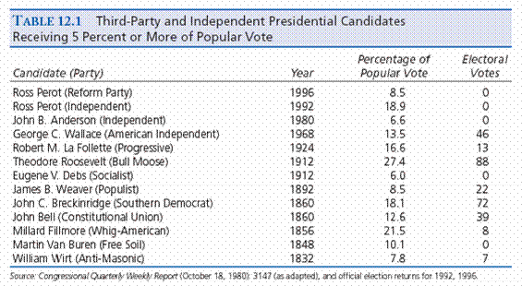
How many elections have been turned by 3rd Party candidates? Probably the elections of 1860, 1912, and 2000 (not shown on table) were turned by 3rd party candidates. The elections of 1848 and 1968 may have also been turned from one major candidate to another, but it’s a closer call in those cases
Notes:
In 2000, Ralph Nader ran as a Green Party candidate and won 2.7% of the popular vote. He didn’t win any electoral votes in the Electoral College but he did steal enough votes from Al Gore in Florida and in New Hampshire to probably turn the election in Bush’s favor.

Slide 11
Third Parties in America
Table. Minority Vote Winners in Presidential Elections
Rank | Year | Candidate | % Popular Vote | % Electoral Vote
1 | 1824 | J.Q. Adams | 30.9% | 32.2%
2 | 1860 | Lincoln (R) | 39.8% | 59.4%
3 | 1912 | Wilson (D) | 41.8% | 81.9%
4 | 1992 | Clinton (D) | 43.0% | 68.8%
5 | 1968 | Nixon (R) | 43.4% | 55.9%
6 | 1856 | Buchanan (D) | 45.3% | 58.8%
7 | 1892 | Cleveland (D) | 46.1% | 62.4%
7 | 2016 | Trump (R) | 46.1% | 56.5%
9 | 1848 | Taylor (Whig) | 47.3% | 56.2%
10 | 1888 | B. Harrison (R) | 47.8% | 58.1%
11 | 2000 | G.W. Bush (R) | 47.9% | 50.4%
12 | 1876 | Hayes (R) | 48.0% | 50.1%
13 | 1880 | Garfield (R) | 48.3% | 58.0%
14 | 1884 | Cleveland (R) | 48.5% | 54.6%
15 | 1916 | Wilson (D) | 49.2% | 52.2%
16 | 1996 | Clinton (D) | 49.2% | 70.4%
17 | 1844 | Polk (D) | 49.5% | 61.8%
18 | 1948 | Truman (D) | 49.6% | 57.1%
19 | 1960 | Kennedy (D) | 49.7% | 56.4%
The Popular Vote in Presidential Elections
Note that 19 of 59 presidential winners won with less than 50% of the vote
The reason: 3rd Parties win votes that would otherwise go to the major candidates
Notes:
In 19 elections, the winner of the presidential election won with less than 50% of the popular vote. Our most recent presidents: Bill Clinton won twice with less than 50%, George W Bush won once with less than 50%, and Trump won once with less than 50%. Biden is the first president to win with more than 50% of the vote since George W Bush in 2004; Biden won with 51.3% of the popular vote.
Some people consider Trump to be a traditional 3rd party candidate who decided to run as a major party candidate, but we have had plenty of presidents who straddle between the two parties, even after choosing to affiliate with one of the major parties, Bill Clinton being one.

Slide 12
Party Power Advantages
On which issues?

Slide 13
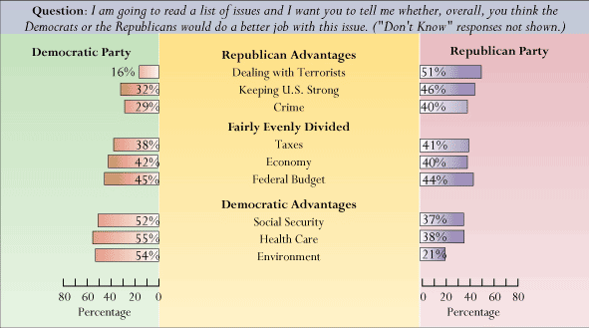
Party Advantages/Disadvantages
Republicans usually have an advantage on national defense and on getting tough on crime
Democrats usually have an advantage on issues involving welfare and the environment
Economic issues are up for grabs, though the tax issue tends to give Republicans more of an advantage than the poll indicates
Notes:
Source: The Polling Report: Nov. 1999, Sept. 2001, Jan 2002
Public opinion is usually the determinant of which issues favor which candidate or party. For instance, in the poll above, a majority of the public believes the Republicans would better handle the issue of terrorism, thus Republicans have the advantage on that issue. That’s an old poll, however. After ordering the killing of bin Laden, Obama and Democrats had an advantage on dealing with terrorists. Still, in most years, Republicans have an advantage on the issue.
From 1968 to 1988, Republicans at the presidential level destroyed the Democrats as being “weak on the Soviets” and “weak on crime”…Bill Clinton came to power after the fall of communism, so national security was not a major issue—and—he made a big deal out of being pro-death penalty. Consequently, Clinton was not labeled as “weak on crime.”
Reagan did not try to reform Social Security (SS). In fact, he increased taxes to shore up SS for another 75 years (which was the estimate at the time). Bush43 tried to sell an SS reform to the public in 2005, after winning reelection, but he paid a heavy price in popularity because the public doesn’t trust Republicans with welfare and entitlement programs. The public would trust Democrats in reforming SS but not Republicans because it was Democrats who created SS.
The public tends to believe that Republicans are the party for rich people. Of course, Republicans think that’s unfair, but nevertheless, that is public perception. On the flip side, Democrats have the reputation of being defenders of the poor and needy.
Obama was an exception
The tax issue was not a factor in the 2008 presidential election either, but perhaps it wasn’t because Obama successfully neutralized the issue by proposing a tax cut for 95% of Americans. In one poll late in the 2008 campaign, Obama was the preferred candidate on the tax issue; to my knowledge, over the last 30 years or so, a Democratic candidate for president has never held an advantage on the tax issue. Obama had tied McCain’s tax cut proposal to health care, and under McCain’s plan (which did not include a tax break for health care costs), the average American would pay more for health care.
It is rare for a Democrat to have the advantage on national security issues, but in 2012, Obama was perceived as having an advantage on national defense. Obama had ordered the killing of Osama bin Laden in 2011, and that made him look tougher or tough enough on dealing with our terrorist enemy. Polls showed in the course of the 2012 election cycle that public trusted Obama more than Mitt Romney (the Republican nominee for president in 2012) on handling the terrorist threat.

Slide 14
Ideology of Party Activists
The Dilemma for Liberals

Slide 15
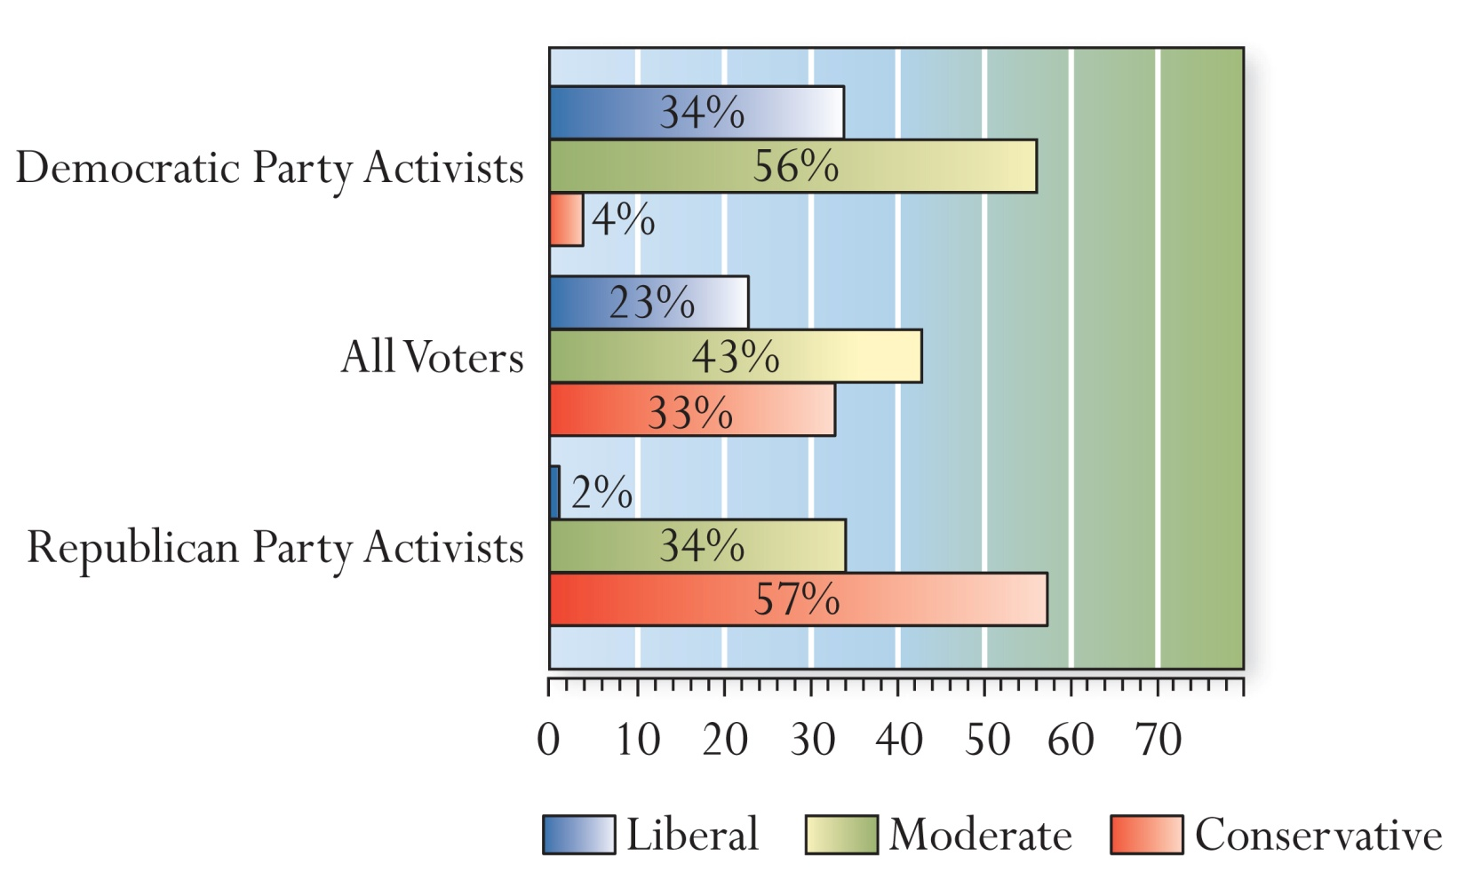
Ideology of Party Activists The Dilemma for Liberals
Party activists are those who work within the party organization to build party support and to elect candidates…they are the dominate voting bloc in primary elections
Notes:
Source: NYT, 2000
Notice the effect of the “liberal label” on Democratic Party activists; most call themselves moderates only because “liberal” is a bad label in American politics. In contrast, “conservative” is a good label. That’s why most Republican party activists call themselves conservative.
Some Background: During the Reagan administration (1980s), “liberals” were discredited as “tax and spend liberals,” as people who wanted to raise taxes so that they could “waste” more of the taxpayers’ dollars. They were also viewed as supporting “welfare queens” (people who would “game” the welfare system to get rich). The word “liberal” has made a small comeback in recent years, but still, most “liberals” call themselves “progressives.” They don’t want to be labeled as “liberal.” So, in polls, many “liberals” classify themselves as “moderates,” which means that polls actually reflect an elevated number of moderates and a suppressed number of liberals. On the other side, being “conservative” is a good or better label in American politics. So, some “moderates” may classify themselves as “conservative,” actually elevating the number of conservatives reflected in polls. The bottom line is this. It is very difficult to accurately measure ideology in polls because of the negative perception of the “liberal” label.
Ideology as measured in Presidential Election Exit Polls
In 2008 (Election Day exit polls), the ideological breakdown in America: Moderates—44%, Conservatives—34%, Liberals—22%
In 2012 (Election Day exit polls), the ideological breakdown in America: Moderates—41%, Conservatives—35%, Liberals—25%
In 2016 (Election Day exit polls), the ideological breakdown in America: Moderates—39%, Conservatives—35%, Liberals—26%
In 2020 (Election Day exit polls), the ideological breakdown in America: Moderates—38%, Conservatives—38%, Liberals—24%

Slide 16
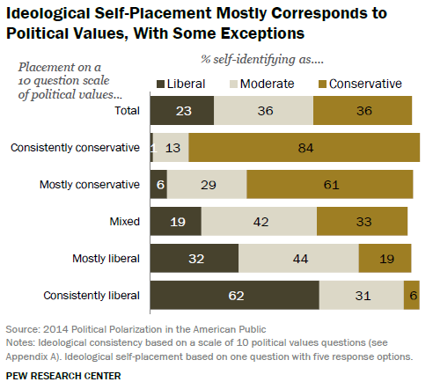
Self-Identified Ideology The Dilemma for Liberals
Notice that among those who are categorized as “mostly liberal” in the Pew Research Center poll, only 32% self-identify as “liberal,” while 44% self-identify as moderate
Contrast that to those Pew categorizes as “mostly conservative.” 61% in this category self-identify as “conservative,” while only 29% self-identify as “moderate”
This 2014 Pew Research Poll illustrates that the perception of the “liberal” label has still not made a full recovery in American politics (see notes below slide for background)
Notes:
Source: Pew Research Center, “Political Polarization in the American Public, How Increasing Ideological Uniformity and Partisan Antipathy Affect Politics, Compromise and Everyday Life,” June 12 2014.
“Liberal” is a bad label in American politics. During the Reagan administration (1980s), “liberals” were discredited as “tax and spend liberals,” as people who wanted to raise taxes so that they could “waste” more of the taxpayers’ dollars. They were also viewed as supporting “welfare queens” (people who would “game” the welfare system to get rich). The word “liberal” has made a small comeback in recent years, but still, most “liberals” call themselves “progressives.” They don’t want to be labeled as “liberal.” So, in polls, many “liberals” classify themselves as “moderates,” which means that polls actually reflect an elevated number of moderates and a suppressed number of liberals. On the other side, being “conservative” is a good or better label in American politics. So, some “moderates” may classify themselves as “conservative,” actually elevating the number of conservatives reflected in polls. The bottom line is this. It is very difficult to accurately measure ideology in polls today because of the negative perception of the “liberal” label. There are more conservatives than liberals in America, but the gap may not be as big as that reflected in polls.
Ideology as measured in Presidential Election Exit Polls
In 2008 (Election Day exit polls), the ideological breakdown in America: Moderates—44%, Conservatives—34%, Liberals—22%
In 2012 (Election Day exit polls), the ideological breakdown in America: Moderates—41%, Conservatives—35%, Liberals—25%
In 2016 (Election Day exit polls), the ideological breakdown in America: Moderates—39%, Conservatives—35%, Liberals—26%
In 2020 (Election Day exit polls), the ideological breakdown in America: Moderates—38%, Conservatives—38%, Liberals—24%

Slide 17
The Politician’s Dilemma
Balancing the “Ideologues, Donor Class, and Party Activists” in each Party (a.k.a., the “base”) and a “Moderate Public”

Slide 18
The Politician’s Dilemma
Party activists tend to be ideological (far right or far left) but the general public is moderate and non-ideological
Primary Elections (when candidates of the same party run against one another): Republican and Democratic candidates have to appeal to their respective ideological bases…or risk losing their core supporters!!
Example #1 – In 2016, Bernie Sanders’ message on health care (single-payer), big banks (more regulation), and billionaires (higher taxes) appealed to the “base” of the Democratic Party
Hillary Clinton struggled to get to the “left” of Sanders, e.g., on banking regulation; she was cautious about taking a more socialist position on health care, worried it would be too liberal a position in the general election
Example #2 – In 2016, Donald Trump tapped in to key preferences of the Republican “base”, on immigration (build a wall, make Mexico pay for it), religiosity (e.g., the “Bible” is his favorite book), and foreign policy (bomb the “s.h.i.t.” out of ISIS)
His opponents tried to portray Trump as a “fake” conservative, but Trump’s “character” appeal (e.g., speaks his mind, can’t be corrupted with money, exceptionally good deal-maker, etc.) gave him a pass on his liberal positions of the past, e.g., on abortion and gay marriage
Notes:
2020: The Democratic primaries in 2020 does not fit well with the narrative on the slide because 2020 was a case in point of the power of the “establishment” within the Democratic Party. The narrative on the slide is an illustration of the power of the more ideological voter in the primaries, both Democratic and Republican, but the “establishment” struck back in the 2020 Democratic primaries.
The 2020 Democratic primaries started as one would expect, with Joe Biden performing terribly. Why would this be expected? Because Biden is a typical politician, who is more moderate and compromising and who has no firm beliefs, so he would not appeal to the liberal base of the Democratic Party in the primaries because the Democratic primary voter is more ideological, looking for a candidate with rock-solid liberal positions and beliefs, and Bernie Sanders fit that profile in 2016 and 2020. Pete Buttigieg was a new face in national Democratic politics, and his “outsider” status (no history in national politics, only having been a mayor at the local level), as well as his being gay (gays are a historically oppressed group, and the liberal base wants to elevate the historically oppressed), also appealed to the liberal base. While Sanders and Buttigieg competed for the top spot in the Iowa Caucus and New Hampshire primary, the first two election contests in 2020, Biden finished 4th and 5th, respectively. Nevada was the 3rd election contest, and Sanders defeated Biden by a much larger margin than most expected (some polls showed Biden ahead by ~2% to 4% prior to the Nevada Caucus, yet Sanders beat Biden by about 20% on Feb. 22nd 2020). It was at this point in the campaign where the Democratic establishment turned on Sanders. The establishment was so scared that Sanders would win the nomination and then be defeated by Trump in the general election that it made a concerted effort to bring down Sanders. I have never read so much negative press about Sanders’ socialist views and slim chances of defeating Trump in the week in-between the Nevada Caucus (Feb. 22nd 2020) and the South Carolina primary (Feb. 29th 2020).
Biden won South Carolina, which was expected because black voters are so prominent in SC, and Biden has historically been favorable to the black community. Still, Biden needed to bury Sanders on Super Tuesday (when 10 states held primaries on the same day, on March 3rd 2020, just a few days after the South Carolina primary), and he was able to soundly defeat Sanders on Super Tuesday because of the cooperation of the other Democratic candidates. Pete Buttigieg and Amy Klobuchar dropped out and endorsed Biden, so their votes went to Biden on Super Tuesday, and Elizabeth Warren (who is far-left like Sanders) stayed in the race through Super Tuesday, dividing the far-left Democratic Primary vote between Sanders and Warren, effectively diminishing Sanders’ vote share. Warren then dropped out after Super Tuesday, after Biden had all but secured the nomination by defeating Sanders resoundingly on Super Tuesday. A week later, the coronavirus pandemic hit America, and all attention was turned to the pandemic and Trump’s handling of the crisis. Biden cruised through the remaining states in the Democratic primaries, easily coasting to the nomination.
Biden’s victory in the 2020 Democratic primaries is a testament to power of the Democratic establishment. Party leaders, including Biden, were able to convince a diverse field of Democratic candidates to get onboard and conspire against Sanders (not in an illegal way—they all just cooperated to ensure Sanders would not be the Democratic nominee) to ensure that Biden would win the nomination, believing that Biden would have a better shot at defeating Trump in the 2020 general election.
Here is how FiveThirtyEight.com explained what happened.
https://fivethirtyeight.com/features/why-buttigieg-dropped-out/?cid=referral_taboola_feed – Cut and pasted: “Elite voices in the Democratic Party have been worried that the multiple center-left candidates in the race — Biden, Buttigieg, former New York Mayor Michael Bloomberg, Sen. Amy Klobuchar, etc. — would divide the non-Sanders vote, potentially allowing the Vermont senator to amass a huge lead in delegates on Super Tuesday while his rivals finished below 15 percent in many states. South Carolina is only one state, but Biden’s resounding win there suggests that the former vice president can combine older, moderate voters, black and white, into a big coalition in a way that Buttigieg probably could not. So my view is that Buttigieg stepped aside in part to help the center-left bloc of the party consolidate around Biden. To some extent, he was being a team player.”
FiveThirtyEight.com goes on, “The Buttigieg departure, in fact, suggests that the Democratic Party establishment has learned some lessons from how GOP party elites allowed President Trump to win the Republican nomination over their objections four years ago. Perhaps Democratic elites are still organized and influential enough to affect party politics. In the time between the Nevada caucuses and today, you heard a bit of a freakout from Democrats concerned about nominating a democratic socialist to take on Trump. But that freakout resulted in some actions — prominent figures in the party urged some candidates to drop out and endorsed Biden. ”
2016: Sanders did so well in the Democratic primaries largely because he is more liberal than Hillary Clinton on most issues. The “base” of the party, or more specifically, the liberal ideologues preferred Bernie’s positions over Hillary’s. The one exception was the gun issue. Sanders comes from a rural state (Vermont), which has a lot of gun owners, so Bernie’s position on guns was more moderate than Hillary’s, and Clinton made a concerted effort to damage Sanders on that issue.
On the other side, Trump’s character (valence) appeal was most important to his supporters. He is a non-politician—he speaks his mind, can’t be bought off (because he self-financed during the primaries), has been a successful deal-maker in the business world (a skill that many believe will translate to politics), and all of these mattered more than his policy positions, many of which are liberal. Prior to his campaign, in the 30 years he was in the public eye as a New York real estate developer, he was pro-choice (though he sold himself as pro-life during the campaign); he was secular (though he insisted that the Bible was his favorite book during the campaign); he was in favor of gay rights and transgendered rights (he has said that Caitlin-Bruce Jenner can use any bathroom at Trump Tower in NYC, even during the campaign); he was in favor universal health care (though his position was to repeal Obamacare during the campaign); he is anti-free trade (he wants fair trade, not free trade); he claims to want an isolationist foreign policy (yet he also wanted to bomb the s.h.i.t. out of ISIS, which is contradictory to isolationism). But Trump’s liberal views didn’t seem to matter. In the Republican primaries, he won the southern states (except Texas because one of his competitors, Ted Cruz, is a US Senator from Texas), where religious evangelicals are strong. Trump took conservative positions on issues that seem to matter most to conservatives, on immigration and on terrorism (e.g., building a wall on the southern border and temporarily suspending immigration from Muslims coming from Syria). That had a neutralizing effect on many conservatives. The only hold outs were some of the ideological conservatives, who were largely in the media. For instance, the National Review, the longest running conservative magazine, was strongly opposed to Trump, and some elected Republicans were also against Trump (e.g., Lindsay Graham, U.S. Senator from South Carolina, who later became one of Trump’s strongest supporters). But conservatives like Rush Limbaugh and Sean Hannity (radio talk show hosts) endorsed Trump. For instance, Rush Limbaugh loves the fact that Trump bashes the media in America on the issue of media bias and that Trump has given a “black eye” to the Republican “establishment,” both of which have been hostile to Limbaugh at times, and those positions Trump has taken matter so much to Limbaugh, who seems to give Trump a pass on Trump’s liberal positions.
2012 Cycle
Take the 2012 Republican candidates for president. To appeal to the base of the Republican party, all of the candidates tried to sell themselves to the Republican electorate as the next “Ronald Reagan.” Why? Because Reagan is a hero among conservatives. His ideology was consistently conservative on social, economic and foreign policy issues (his actions as president were not consistently conservative, because of the various political pressures to which a president must conform to be successful and to get reelected, but conservatives either ignore or forgive Reagan’s inconsistencies in practice). Republican voters want a consistent conservative, at least an ideologically consistent conservative (not necessarily consistent in practice).
2012: Mitt Romney chose Paul Ryan as his VP nominee. Ryan is well-liked among the Republican base because of his reputation as a “budget hawk,” wanting to cut government spending. Romney chose Ryan because he needed a VP to excite the Republican base. Romney did not excite the base because he was a moderate Republican governor who had taken liberal positions in the past.
2008: Hillary Clinton (D) voted in favor of authorizing the president to fight war in Iraq (2002 vote), which was very unpopular with the liberal base of the Democratic Party. Needing a victory in the Texas and Ohio primaries (March 2008), Hillary declared for the first time that she regretted her vote to authorize the use of force in Iraq…this was a move to try to neutralize Barack Obama’s advantage with the liberal base, given that Obama had opposed the Iraq War from the outset
2008: John McCain chose Sarah Palin, a pro-life pro-gun conservative, as his running mate. The conservative base loved the pick. McCain really wanted to chose Senator Lieberman as his running mate (Lieberman was a Senator who was pro-war on the issue of Iraq) or Tom Ridge, a pro-choice Republican, or in the final days before choosing a VP nominee, Tim Pawlenty (a two-term Republican governor of Minnesota, who is a moderate). Instead, McCain chose to cater to his conservative base. He did not sufficiently shore up his base in the primaries (because of his long history of being a moderate on many issues core to conservatives, like taxes and immigration). Some argue that McCain chose Palin to win the female vote. There is some truth to this argument because Republicans are badly in need of high-profile women (and blacks) in order to better compete with Democrats for the votes of women (and blacks), but this was not the core reason for McCain’s choice. If it was, other women would have topped McCain’s the list of prospects, but the other top choices were men. In contrast to McCain, Obama’s base was so appreciative of his position on the war (he opposed the Iraq War from the outset) that he had flexibility to take some harder stands not favorable to the base (like a tax cut for 95% of Americans and continued airstrikes into Pakistan).
Another example: In 2005, John McCain (R) brokered a compromise on conservative judicial nominees to the federal courts and he had been moderate on the issue of illegal immigration. These are behaviors and issue stances that are unfavorable to conservatives, so McCain needed to “prove” he was a true conservative in 2008 in order to win the enthusiastic support of his base. In the primaries (2008), McCain stressed conservative positions on the types of judges he would appoint, and he adopted the conservative position on illegal immigration to first stop the flow into the country.
Another example: John Kerry (D-MA) (2004 presidential candidate) voted for the war in Iraq and then voted against the additional appropriation for the war once he started catching heat from Howard Dean in the primaries. Of course, Kerry would argue that he had objections to the $87B appropriation for principled reasons (it did not provide body armor for military vehicles)
Another example of McCain’s compromising character (which irked base conservatives): During Bush’s first term in office (2001-2005), the Democrats in the Senate filibustered 10 of Bush’s more conservative judicial nominees to the federal courts. What this meant was that the Democrats were not allowing the whole Senate to vote to reject or confirm these nominees. It takes 60 votes in the Senate to break a filibuster, but Republicans only had 55 seats and could not attract 5 additional Democrats to vote with them (in other words, all 45 Democrats stuck together in favor of sustaining the filibuster). After Bush was reelected, Republicans in the Senate wanted to push for a vote on Bush’s nominees. To do so, Senate Majority Leader Bill Frist (R-TN) threatened to change the rules to get rid of the filibuster, which had been a Senate tradition for more than 150 years. Not wanting to break tradition, Senator McCain (R-AZ) organized 7 Republicans (including himself) and 7 Democrats to broker a compromise. The compromise was this: Senate Democrats would allow 3 of Bush’s nominees a vote provided the rule allowing for the filibuster remain in place. In the end, Bush got 5 of his 10 nominees confirmed to serve in the federal courts, and then later, Bush nominated 2 new members to the US Supreme Court, and the Democrats did not filibuster those nominees. Both are sitting on the Supreme Court today.
The core Republican base did not like the compromise; they wanted Frist to get rid of the filibuster and then ram through all of Bush’s nominees (some of the nominees had withdrawn their names from consideration, so the number would have been less than 10). So, these core Republicans were unhappy with McCain because he had compromised so often with Democrats.

Slide 19
The Politician’s Dilemma
Party activists tend to be ideological (far right or far left) but the general public is moderate and non-ideological
General Election – When candidates of different parties run against each other, candidates must appeal to the moderates in the center
Both Republican and Democratic candidates must moderate their positions to appeal to the vast majority of the ~130 million voters in America who are moderate, not ideological
Example 1: In 2016, Hillary Clinton was positioned fairly well in the general election because she is part Democrat (e.g., in favor of universal health care), part Republican (e.g., a little tougher on foreign policy than most Democrats, such as recommending more U.S. involvement in Syria)
Though Hillary Clinton had problems with “trust” and “enthusiasm;” she demonstrated a degree of dishonesty (the email scandal) that stood out and she did not excite the “base” of the Democratic Party
Example 2: In 2016, Donald Trump was also positioned fairly well in the general election because he is part Republican (e.g., tough on immigration), part Democrat (e.g., anti-free trade, pro-gay rights)
Though Trump did not poll well with minority voters (blacks, hispanics, women) and he had a portion of the Republican Party rebel against him, given his authoritarian qualities and liberal positions
Notes:
2008: Given that McCain was moderate on many issues, John McCain (R-AZ) should have been positioned to do well in the general election for president in 2008, but McCain’s “hawkish” stand on the Iraq War hurt him with swing Democrats, and because of his problems with the conservative base (the conservative “base” did not trust that McCain would govern as a “real” conservative; McCain had been too compromising with Democrats throughout his career in the Senate), McCain had positioned himself as being “too conservative” for moderates
2008: Barack Obama took a slightly harder stand on foreign policy, since the public generally likes “toughness.” Obama promised to continue Bush’s policies of airstrikes inside Pakistan to target leaders of Al Qaeda, even without the permission of Pakistan. Obama positioned himself as the “tougher” candidate on this issue, which positioned him well in the general election against John McCain. Democrats are often labeled as being “weak on America’s enemies,” but that label did not apply to Obama in 2008. “Toughness” was not a decisive issue in the 2008 presidential election, but had it been, Obama would have been positioned well on the issue.
2012: The same was true of Barack Obama in 2012 on the national security issue. He even polled better than Mitt Romney on the question, “which candidate would better handle terrorism?” Incredibly, the Democrat was trusted more than the Republican on national security.
2020: Biden conforms pretty well to the narrative on the slide above, which posits that in a general election, a moderate like Biden is better positioned to appeal to the more moderate voter who votes in a general election. What is different about 2020, however, is how strong the “anyone but Trump” sentiment was among the voting (more moderate) public. 2020 was not so much about Biden’s appeal but more about the desire of the average voter to defeat Trump.
Even before the coronavirus outbreak (mid-March 2020), the most significant factor in the 2020 presidential election was how strong the “anyone but Trump” sentiment would be, but once the coronavirus pandemic hit America, it all but spelled the end for Donald Trump. Trump was not a crisis leader, i.e., he did not have the type of personal appeal necessary to calm a public prone to panic during a crisis. Instead, he tried to downplay the crisis and just wish it away, telling the American people that the virus would go away on its own, but that did not come across as reassuring to the public. Though, being a real estate tycoon, Trump is a person who gets things done (skyscrapers and resorts have to be built), and being a man of action, he was instrumental in clearing away “red tape” so that drug manufacturers could develop a vaccine in record time, but when word of an effective vaccine made the news, it was two weeks after the presidential election, a little late to save Trump’s presidency. In contrast, Biden is “all heart.” He has an empathetic quality about him, stemming from his suffering from great loss as a younger man when his wife and daughter were killed in a traffic accident in 1972. Ever since, Biden has had the ability to help people through their own tragedies, given that he has had to deal with so much tragedy in his own life, not just his wife and daughter being killed but also his son Beau Biden died of brain cancer in 2015. Biden’s empathetic character was made to handle the coronavirus pandemic, during which so many people have lost loved-ones. Politically, Biden may be the perfect person to handle this crisis. He has the type of personality that can gain the trust of the American people, particularly in this crisis, where 400,000+ people have died (as of January 2021), because he can legitimately say that he knows what people are going through. And once a leader gains the trust of the public, his policies on addressing the crisis are more likely to gain the support of the public.
The coronavirus pandemic and the “anyone but Trump” sentiment amongst the voting public helped Joe Biden win the presidency in 2020.

Slide 20
The Politician’s Dilemma
Once in power, can a politician ignore the party base?
No! A politician must cater to the base (the core ideologues) as well as to the center of the political spectrum (the moderates)
Ignoring the party base has devastated many presidents
11 of 45 presidents have lost their own party’s support throughout American history…each was ruined politically
In the modern era (past 50 years or so), presidents who lose their party base invite primary challengers in the next election
In the distant past (the 1800s), presidents were dropped by the party and were not re-nominated to run for a second term
Some more recent 20th and 21st Century examples:
LBJ – Opposition to the Vietnam War invited 3 “peace candidates” to challenge LBJ in the Democratic primaries…LBJ decided not to run for re-election in 1968
Gerald Ford – Ford, being too moderate, invited a challenger on his right (Ronald Reagan) in the primaries…Ford beat Reagan but went on to lose to Jimmy Carter in the general election of 1976
Notes:
Though Chris Christie is a (Republican) governor of a state (New Jersey), the scandal involving an abuse of government power (closing lanes on the George Washington bridge as political payback for a Democratic mayor’s refusal to endorse Christie in his 2013 reelection bid as governor and the alleged withholding of Hurricane Sandy relief funds from another mayor for refusal to back a development project Christie wanted developed) received the media attention of a presidential scandal, probably because Christie, at least pre-scandal, would have been a formidable competitor to Hillary Clinton in the 2016 presidential race. A key factor hurting Christie in his effort to survive the scandal is that the core Republican base (the conservative ideologues and Republican Party activists) don’t like Christie because he was too friendly to President Obama and he has taken some moderate to liberal positions on immigration and gay marriage. In other words, Christie has not catered to his “base” on key issues that are important to the “base” of the Republican Party, and as a consequence, the voices (in the media and on the internet) supporting Christie have been muted and few in number when compared to the volume of liberals and Democrats in opposition to Christie. Presidents (and serious presidential contenders like Christie) suffer when they don’t have their “base” defending them in a crisis atmosphere. The “moderates” of America hear the critics (of Christie in this case) more loudly, and thus are more likely to be persuaded to oppose the politician embroiled in the scandal (again, Christie in this case).
As it turns out, Christie ran for president in 2016 but he did not do well in the Republican primaries and dropped out. He was ruined politically by his friendly relationship with Barack Obama and for some of the liberal positions he had taken, as well as the George Washington Bridge scandal back in 2013.
President’s who lost support of their own parties:
1. John Adams – Quasi-War…Adams’ party wanted all-out war with France, while the opposing party opposed war with France. Adams split the difference, but party leaders turned to Hamilton for leadership. Adams ran for reelection but lost to Jefferson.
2. James K Polk – Mexican-American War controversial at the time, thought to be unconstitutional…Western Democrats turned against Polk when he failed to go to war with GB over Northwest Territory…Polk was not re-nominated by party leaders to run for reelection; he served only one term as president
3. Fillmore – the pro-slavery provisions of the compromise of 1850 was too controversial, and Fillmore supported the compromise…he too was not re-nominated by party leaders
Pierce – desire to purchase Cuba, viewed as an attempt to spread slavery…violence in the Kansas Territory over the slave issue hurt Pierce…again, party leaders did not re-nominate Pierce
Buchanan – LeCompton Compromise for Kansas a disaster…Buchanan did nothing to resolve the slave issue
Chester Arthur – not re-nominated by party leaders
Grover Cleveland – took a stand on the Gold Standard, split the Democratic Party in two…Cleveland supported a 3rd Party candidate in 1896
LBJ – destroyed by the Vietnam War…invited 3 challenges in the primaries…LBJ decided not to run for reelection
Nixon – Watergate, Republicans could not support him…Nixon resigned over the controversy
Carter – invited a challenge from his left flank (Ted Kennedy); Carter was too conservative for the Democratic Party
Bush41 – invited a challenge from his right flank (Pat Buchanan); he compromised on the tax issue (raised taxes)

Slide 21
The Politician’s Dilemma
Once in power, can a politician ignore the party base?
Carter – Carter, being too conservative for the Democratic Party, invited a challenger on his left (Ted Kennedy) in the primaries…Carter lost the general election to Reagan in 1980
Bush41 – After raising taxes and generally abandoning the Reagan domestic agenda (e.g., Bush approved more regulations: clean air act, clean water act, Americans with Disabilities Act), Bush41 invited a challenge on his right from Pat Buchanan in 1992
Bush won the primary elections over Buchanan
It’s not clear whether Perot’s entry as a 3rd Party candidate hurt Bush or Clinton more, but Perot’s candidacy did indicate that neither party was addressing the issue of the budget deficit
Clinton was a rare exception: He never catered to his party base
After being out of power for 12 years, Democrats wanted a winner
Clinton had no challengers from the left, even though he took quite a few conservative stands (e.g., welfare reform, deregulation, free trade)
Bush43 had no challenger in 2004; Obama had no challenger in 2012
Trump & Biden: Trump had three (3) Republican competitors in 2020, albeit none who was a serious threat to Trump’s eventual nomination; Biden has two (2) Democratic competitors in 2024, though none a serious threat to his nomination
Both are examples of their respective “bases” not being completely satisfied
Notes:
2024 Primaries – Biden has two (2) competitors for the Democratic nomination in 2024, Robert F. Kennedy Jr. (son of the late Robert F. Kennedy, who was assassinated in 1968 while he was running for president) and Marianne Williamson, who also ran in 2020. Biden has unified the Democratic Party on policy issues, though there are a majority of Democrats who don’t want him to run again, presumably because of concerns about his age (Biden will be 82 in 2024, and he is already the oldest president in our history). Still, Bernie Sanders is unlikely to challenge Biden because Sanders is pleased with Biden’s policy agenda and legislative accomplishments, which have been more ideologically liberal, e.g., investments in green energy, health care, infrastructure, technology, and more.
2020 Republican Primaries
Trump had three (3) Republican challengers in the 2020 Republican primaries: William Weld, a former Governor of Massachusetts and the VP Nominee for the Libertarian Party in 2016, 2) Joe Walsh, a former conservative member of the U.S. House from Illinois, and 3) Mark Sanford, a former Governor of South Carolina and more recently a one-term member of the U.S. House from South Carolina. None of these candidates were a serious threat to Trump’s eventual nomination as the Republican presidential candidate.
Some state parties tried to protect Trump from these competitors by calling off primaries in their states; it is not supposed to work this way, where the party power players simply eliminate challengers to the incumbent president by not holding primary elections. Still, there were divisions within the Republican Party in 2020.
2012 Republican Primaries
Some analysts argue, and the Republican “establishment” believes, that a long drawn-out battle among the Republican candidates in 2012 would hurt the eventual nominee’s chances of winning the general election against Obama. That may not be true, however. The Democratic nomination race between Barack Obama and Hillary Clinton did not damage Obama in the general election. What is true is this. If an incumbent president running for reelection faces a challenger, the primary challenger is typically damaging to the incumbent (see examples on this and the last slide). Neither Hillary or Barack were incumbents in 2008, and in 2012, none of the Republicans running for president were incumbents.
Obama is positioned well for 2012. He has given his base health care reform, financial reform, environmental regulation of CO2 from tailpipes of cars and trucks, and in part, a “good neighbor” foreign policy. Even though his base wants more and they sometimes grumble about Obama not achieving enough as president, they were happy enough not to support a primary challenger against Obama.
Clinton felt guilty; he wanted to pay back the party base for selling out on Welfare Reform (1996). In early 1998, Clinton proposed expanding Medicare and SS…he also wanted more money for education…and then came the Monica Lewinsky Affair, which killed his more liberal agenda to pay back the liberal base for his previous compromises with Republicans
Bush43 signed the Campaign Reform Act of 2002, John McCain’s pet project…perhaps this “bone” to McCain kept McCain out of the race in 2004—or—perhaps McCain felt he’d better wait until 2008 to make his bid for the presidency.

Slide 22
Polarization

Slide 23
The Effect of Polarization Targeting the President
The parties are increasingly polarized
The causes of polarization:
Personal distaste (even outright hatred) for a political leader
Democrats on Nixon – Nixon was a sleaze who wouldn’t hesitate to destroy someone for political gain…Nixon allegedly trumped up charges of communism on Alger Hiss (1948), destroyed Hiss’ career
Republicans on Clinton – Clinton is everything anathema to “family values”: a dope head, draft-dodger, “un-American” anti-war protester (in Vietnam), an adulterer, and a habitual liar
Opposition to Trump – Trump is a thin-skinned child, a misogynist (i.e., disrespectful to women), and anti-intellectual (i.e., not curious to learn what he doesn’t know)
Intense policy differences (e.g., Vietnam War, Reagan’s escalation of the Cold War, War in Iraq, Obama’s activist agenda on health care)
Democrats on Bush 43 – With the war in Iraq, Bush made America less safe by attracting more terrorists to the cause of destroying America and by distracting from Afghanistan, where the US military should have been focused
Republicans on Obama – Obama is a socialist at heart; he wants America to be like the European social democracies with universal health care, stronger regulation of the economy, and high taxes
Notes:
Trump has both Democratic and Republican opposition, so that’s why I labeled his entry on the slide, “Opposition to Trump.”
The Alger Hiss Case
In Nixon’s case, Democrats hated Nixon for destroying Alger Hiss in 1948, a communist spy. At the time (1948), Democrats believed Hiss (an employee in the State Department) was an innocent man whom Nixon destroyed for political gain. Nixon became a star in the Republican Party after the Hiss case; he gained strong anti-communist credentials. After the fall of the Soviet Union in 1991, Russia confirmed that Hiss was a spy for the Soviet Union, but no one knew this with certainty prior to the collapse of the Soviet Union.
Background: Alger Hiss was an employee of the Department of State. Early in Nixon’s career (1948), he exposed Hiss as a communist (this was during a period of heightened fear about the spread of communism throughout the world). Democrats felt Hiss was an innocent man, that Nixon destroyed an innocent man’s career just to promote himself within the Republican Party. Nixon was rewarded in Republican Party as a trusted Cold Warrior after Hiss was exposed. After the fall of the Soviet Union in 1991, the Russians opened their Cold War files and it turned out that Hiss had been a communist spy for the Soviet Union, but this wasn’t known for sure until after 1991.
Reagan’s Policies
In Reagan’s case, Democrats were worried that Reagan would make radical changes to politics in America, that all of the liberal gains of the previous 50 years would be reversed. As a consequence, Democrats viewed Reagan as a major threat who had to be stopped before he ruined the country. The hatred for Reagan was not directed at him personally, as it was for Nixon and Clinton, but at the potential of Reagan’s policies.
In Clinton’s case, Republicans hated Clinton because they viewed him as being on the wrong side of the cultural war. Republicans feel that the nation’s morals are in decline and that Clinton embodied immorality: cheats on his wife, allegedly smoked marijuana, allegedly protested the Vietnam War in the heart of America’s Cold War enemy (Moscow), etc. Though Clinton had no part of Woodstock (the 1960s rock concert where everybody got stoned for 3 days), Republicans view him as one of those societal drop outs who attended Woodstock. At the same time as Woodstock, America was landing a man on the moon for the first time. To Republicans, this was the contrast that Clinton made so starkly real. On the one side was America at its best (NASA scientists putting a man on the moon) and on the other was America at its worst (Woodstock). Republicans looked at Clinton and saw everything that was Woodstock.
Bush was also hated by his opposition. Though Bush was derided as a dumb ass and a moron, Bush’s opposition was most outraged about his policies, particularly the Iraq War. The opposition believed that the Iraq War was a disaster, that America’s image in the world precipitously declined as a result, that Iraq became a training ground for terrorists (at least from 2004 to 2008), that America should never have invaded a country that did not attack or threaten to attack America.
Similar to Reagan, Obama’s opposition is threatened by his agenda. His harshest critics call him a socialist and charge that he hates the founding principles of America. They are most threatened by Obama’s agenda on health care and “cap and trade” (environmental regulations). Some believe that racism is at the heart of the criticism, but that’s not correct. Reagan was an ideological president, and so is Obama, and the ideologues are major threats to their opposition.

Slide 24
The Effect of Polarization The Causes
The parties are becoming increasingly polarized
One potential cause of polarization:
No traction on policy – Neither Republicans nor Democrats can move the country to the right or left because the margins between them in Congress are close
Why is this? Polling and focus group testing allows the parties to adjust positions quickly (i.e., co-opt issues that favor the opposition)
As a result, a possible realignment of the parties becomes more remote…no big changes in policy are possible if no one party can garner a significant edge
Examples: Clinton co-opted Welfare Reform, which was an issue that favored Republicans; Bush43 co-opted prescription drugs for the elderly, which was an issue that favors Democrats
The financial crisis (2008-2014) gave Obama some traction, but he too faced stiff resistance, especially on health care
This lack of traction on policy has led to very high frustration levels…increased bitterness
Frustration levels remain high on both sides today because the two parties remain very competitive (there is no one dominant party today)
Notes:
When one political party becomes very dominant and the other very small in number, there is less polarization. The dominant political party determines policy, and the very small minority party becomes very meek and resigned in its opposition—it takes on the attitude of “go along to get along.” But when margins are close, meaning that either party could potentially win a majority in Congress or win the presidency in the next election cycle, polarization increases.
Co-opting issues contributes to polarization. Cooption occurs when one party steals an issue from the other party to neutralized the advantaged party’s edge. For instance, taking care of the elderly is an issue that favors Democrats. So, Bush proposed adding a prescription drug benefit to Medicare to help the elderly pay for prescription drugs. After that, Bush could claim he wanted to help the elderly, so Democrats could no longer charge that Republicans don’t care about the elderly. Bush’s move took that argument away from Democrats.
Clinton co-opted issues from Republicans also (e.g., welfare reform, anti-gay rights (Clinton signed DOMA), and war (Clinton dropped a lot of bombs as president)). Both parties do this, despite that it enrages the base of support in both parties. The core ideologues in the party opposite of the president consider the tactic of co-option to be outright theft, and the ideologues in the president’s party consider it to be “selling out” on principle. The effect of co-option is to take away any policy advantages one party may have over another. Without clear distinctions between candidates or parties, then neither party can win big in the next election.
In this latest housing/credit/financial crisis (2008 to present), big moves to the left have occurred. For instance, the federal government now controls the largest home mortgage lenders (Fannie Mae and Freddie Mac); it has an 80% stake in America’s largest insurance company (American International Group); the government has intervened in the investment banking industry for the first time (e.g., the government intervened to facilitate the sale of Bear Sterns); the government has invested in commercial banking industry (The Toxic Assets Relief Program (TARP)); and the government initially took a 60% stake in General Motors and it provided over $6 billion to prop up Chrsyler. All of these moves have been possible because of the crisis atmosphere in America today. Even so, President Obama feels compelled to tell the public that he has no interest in controlling banks and running car companies, which means that he believes the political culture in America does not accept so much government control of the economy, so he wants to assure them that he has only taken these measures (and continued them from the Bush administration) because of the crisis situation. That way, he won’t lose a lot of supporters to the Republican Party.

Slide 25
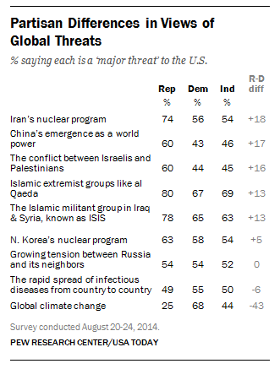
The Effect of Polarization Differing Partisan Perceptions (2014)
In 2014, Republicans tended to view threats in the world as “more threatening” than Democrats
Republicans tend to view America as unambiguously “good,” thus creating a larger perception gap between “good” and “evil” in the world
Democrats tend to see problems here at home, such as inequities based on income and race, and thus find a smaller perceived gap between the U.S. as a force of “good” versus the “evil” that exists in the world
Though since 2022, after Russia invaded Ukraine, Democrats have viewed Russia as much more threatening than Republicans
Notes:
Source: Pew Research Center, “As New Dangers Loom, More Think the U.S. Does ‘Too Little’ to Solve World Problems,” August 28, 2014. Reponses obtained from 1501 respondents between August 20 – 24, 2014.

Slide 26
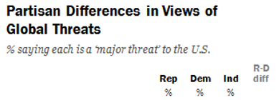
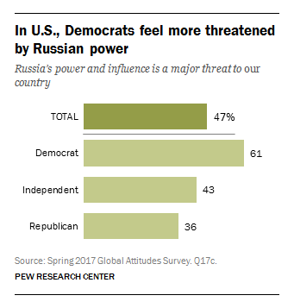

The Effect of Polarization Trump Influence on Partisan Perceptions of Russia
Trump was more favorable toward Russia, and this had a “cueing” effect on both Republicans and Democrats. In 2017, Democrats viewed Russians as more threatening in opposition to Trump and Republicans moved with Trump, viewing Russia as less threatening
2014 – Pre-Trump
2017 – Post-Trump
Notes:
Source: Pew Research Center, “As New Dangers Loom, More Think the U.S. Does ‘Too Little’ to Solve World Problems,” August 28, 2014. Reponses obtained from 1501 respondents between August 20 – 24, 2014.

Slide 27
History of the Party System

Slide 28
History of American Political Parties
Major Parties
Democrats and Republicans have been the major parties in America since 1856
3rd Parties
Third party challenges have occurred often throughout US history

Slide 29
History of American Parties
Parties sometimes change positions to cater to certain elements of the public
The goal: Maintain the support of a constituency which has changed positions or to attract new support from another constituency
The Republicans
Republicans changed positions on “free trade” to maintain business interests within the party
Republicans opposed “free trade” when businesses were less global in scope (up until the 1950s), but switched to a “pro-free trade” position when business expanded internationally
Trump was for “fair trade,” which is effectively a position opposed to free trade
Republicans attracted conservative Democrats by adopting a more conservative stance on social issues, particularly on civil rights (race) but also on abortion and (anti-) gay rights…and on use of force & war
Republicans were the “liberal” party on civil rights (equity for blacks) between 1860 and 1960, but then became more conservative in the 1960s
Republicans attracted conservative Democrats on the issue of war and the use of force by becoming more “hawkish” during the Vietnam era
Republicans attracted religious conservatives on the social issues (e.g., pro-life on abortion and opposition to gay rights) in the 1970s & 1980s
Notes:
Republicans were more liberal on social issues, including on equality for blacks, from 1860 to the 1950s, but then became more conservative in resisting Civil Rights in the 1960s. The (white) religious conservatives were evenly split up until about 1984 between the two parties. Jimmy Carter actually won a greater % of white evangelicals in the 1980 presidential election, even though Ronald Reagan ushered in a new era of religious conservatism (as well as economic and foreign policy conservatism) in America. Carter was an evangelical Christian (who actually went to church, unlike later presidents—Reagan, Clinton, Obama, and Trump, who didn’t go to church).
“Hawkish” – a more aggressive view on using force or going to war; an almost pro-war, pro use-of-force position
“Dovish” – a less aggressive view on using force or going to war; an almost anti-war, anti-use of force position

Slide 30
History of American Parties
Parties sometimes change positions (continued)
The Democrats
Democrats have appealed to a more secular (less religious) constituency, beginning in the 1970s
The Democrats have attracted those who are pro-choice on abortion and pro-gay rights and generally more tolerant regarding personal freedoms (that some consider to be immoral)
The religious element of society was once evenly divided between the Republican and Democratic Parties (1950s-70s)
In the late 1800s & early 1900s, Democrats even catered to the most religious element in society: there was a “religious left” movement that was socially conservative (advocated banning alcohol) but very liberal on economic issues (promoted socialism)
Democrats championed civil rights (equity for blacks) in the 1960s
Minorities (especially blacks but Hispanics, Asians and even women also) have tended to vote more for Democrats since
Democrats became more “dovish” during Vietnam
Prior to Vietnam, neither party held an advantage on being “tough against America’s enemies,” but Republicans do now, which has hurt Democrats when national security is a relevant issue (though Obama was an exception because he had Osama bin Ladin killed)
Notes:
Democrats became peace advocates during the Vietnam Era. This hurt the party in presidential elections between 1968 and 2008 because many “hawkish” (conservative) Democrats switched to the Republican Party (that switch occurred between 1968 and 1988). Democrats faired poorly in presidential elections when the public has felt threatened by an “enemy.” From 1968 to 2008, Republicans held the presidency in 28 of 40 years. Jimmy Carter was president for 4 years, and Clinton for 8 years, but Clinton championed a lot of conservative issues (welfare reform, free trade (NAFTA), tax cuts (though only in rhetoric), and war (Kosovo)). Still, this is a matter of principle for Democrats. Even though they were at a disadvantage on issues of war and the use of force, they remained more “dovish” and greater supporters of “peace advocacy” than Republicans.
In 2022-23, the irony is this regarding the Ukraine-Russia war. Democrats have become the more “hawkish” political party, seemingly determined to support Ukraine until the Ukrainians can push the Russians out of their country, while the Trump-wing of the Republican Party has become more “dovish,” making arguments such as that we risking a nuclear exchange with Russia and that we could be provoking WWIII. Ironically, risking a nuclear exchange and provoking war was an argument liberals and Democrats made in the 1980s, when then President Reagan was escalating the Cold War between the U.S. and the Soviet Union (Russia was the largest and most powerful country in the Soviet Union).
At the 2012 Democratic National Committee, the word “God” was removed from the Democratic platform. The removal caused so much controversy that the Democratic Platform Committee inserted “God” back into the platform. “God” is mentioned once in the Democratic platform; “God” is mentioned 7 times in the Republican platform. The attempted removal of the word “God” is an indication of the secularization of the Democratic Party and its members.

Slide 31
History of American Parties A realignment of the political parties today?
Has the Trump Presidency sparked a realignment?
It is possible that Trump’s influence will turn out to be an aberration, but it may also be the start of a party realignment
How Trump’s policies veered from the party norm
Trade – Trump favored higher tariffs as a punishment for China and other countries that break the rules of free trade…this is protectionism, a position that the Democratic Party had previously championed for decades
Working Class Whites – Trump’s populism appealed to “blue collar” white workers (e.g., factory workers and others who do “dirty” jobs, like construction), a group of voters that voted mostly for Democrats since the 1930s (with the rise of labor unions)
This is tied to the trade issue because Trump promised to bring back manufacturing jobs to America, which has moved to other countries because of “cheaper labor”
The Wealthy Business Class – The Republicans have had the reputation of being the “party of the rich” for decades,
But the powerful business class turned on Trump, e.g., Big Tech and Big Money, to ally with the Democratic Party to defeat Trump in 2020
Notes:
Perhaps immigration should be on the list above too, but the anti-immigrant sentiment that Trump exhibited was a sentiment in the Republican Party before Trump hit the political scene in 2015. It just became a dominant view under Trump. But one reason immigration should possibly be on the list is because the argument that immigrants take jobs from working-class Americans was a more dominant sentiment in the Democratic Party for many decades, coinciding with the position of labor unions, which are threatened by cheaper labor. The strength of unions has diminished over time, and now the Democratic Party sees immigrants as future voters, so more so than the Republican Party, the Democratic Party has changed on the immigration issue because it wants more voters.

Slide 32
History of American Political Parties
Political Parties have Disappeared
The Federalist Party
The Federalist Party disappeared after the War of 1812
Federalists in the New England states were discredited for considering secession in opposition to the war
The Whig Party
Whigs failed to address the slavery issue…Republicans, as a 3rd party, seized the issue and displaced the Whigs as a major party in 1850s
The Republicans were the only 3rd Party in US history to displace a major party
Will either the Republicans or Democrats disappear?
Highly Unlikely: The parties today monitor public opinion so closely that they can adjust their positions on the issues quickly, to avoid the mistake the Whig Party made on the issue of slavery
To divert support away from a rising 3rd party, one of the major parties will simply adopt popular 3rd party issues…resulting in the demise and eventual disappearance of the 3rd party
Notes:
Why did the Federalist Party disappear?
Federalists in New England states considered secession from the union in 1814, and once the plan to secede was exposed, the party never recovered. Had the New England states seceded from the union in 1814, then the country could have fallen apart and become prey to one of the other powers in the world: Britain or France. So, even the thought of secession was traitorous; it was considered a threat to the democratic experiment this country had introduced to the world.
What did the Federalists want? They were staunchly anti-war; they wanted a friendly alliance with Great Britain.
The (Jeffersonian) Republican party then dominated American politics from 1814 to early 1830s. This era of one party rule in America was called the “Era of Good Feelings.” In early 1830s, the Republican Party reformed under the leadership of Andrew Jackson and became known as the Democratic Party
Why did the Whig Party disappear?
The Whigs were formed in opposition to Andrew Jackson, America’s first intensely polarizing president. The Whigs never built a grassroots organization; it survived by recruiting big names: William Henry Harrison (hero from War of 1812), Zachary Taylor (hero from Mexican-American War), Henry Clay (powerful member of the US Congress). The party disappeared because it failed to address the slavery issue. Republicans, as a 3rd party, seized the issue and displaced the Whigs as a major party in the late 1850s, just before the outbreak of the Civil War.
Andrew Jackson wanted to limit the growth of the federal government, killed the national bank, transferred money to state banks, vetoed funding for construction of canals (a.k.a. internal improvements)…also Jackson wanted the Indians removed from Alabama and Georgia. These were the big issues of that day, and there was intense opposition to each of Jackson’s positions.

